Slide 1
English Proficiency Evaluator
Solution Demo
Andy Orlosky
AWS Solutions Architect
aorlosk@amazon.com
June 18, 2025
Notes:
intro of my role as a solutions architect. It appears we have some new faces today, so before we get started can everyone introduce their name and role. Name
Role
Highlight the purpose of this meeting: demo of architecture in the AWS console.
For the capstone, I built an application to address a need of one of my customers (Edusynch). This project provides transcription and evaluation of English Proficiency exams globally. To address this need, I designed an architecture that leverages AWS Step Functions to orchestrate serverless processing via AWS Lambda to transcribe your exam (Amazon Transcribe) and pass this output to a foundational model for evaluation in Amazon Bedrock. This application leverages the CEFR standard (Common European Framework of Reference for Languages) for evaluation and provides feedback based on how the speaker performed to automate assessment analysis.

Slide 2
Agenda
Review Current Business Challenges
English Proficiency Evaluator Tool Demo
Architectural Overview
Pricing Estimates
Next Steps
Notes:
Agenda:
Review the current challenges discussed in our last meeting.
Demonstrate the English Proficiency Evaluator
Review the architecture components that I will demo today in the console.
Provide a monthly pricing estimate and some next steps you can take after this meeting to start the account setup process.
If there is something you see in the console or my presentation that you want to know more about, please don’t hesitate to ask. I will be taking notes to follow-up with any action items we want to dive deeper into as we go along.

Slide 3
Current Challenges
Evaluate High Stakes English Speaking Exams for Proficiency
Use CEFR standard (Common European Framework of Reference for Languages) for evaluation
6 Reference Levels from beginner to mastery (A1 – C2)
Provide Transcription of Assessment for Compliance
Agility of Model Selection for Best Performance
Heavy Traffic During Exam Seasons
Following Responsible AI Best Practices

Slide 4

English Proficiency Evaluator Demo!
Notes:
Demo of different components, start at front-end web page and drill into different components (starting from AWS console overview)
- Be able to field questions the entire time.

Slide 5



Key Services
Amazon Transcribe
AWS Lambda
Amazon Bedrock
Notes:
Amazon Transcribe: Automatic speech recognition (ASR) service that converts audio to text, opens the door for text analytics on voice input, today we will be integrating it with Amazon Bedrock for speech analysis
Key features:
Real-time and batch transcription
Support for multiple languages
Custom vocabulary and language models
Speaker identification
Automatic punctuation and formatting
Qs: supports content redaction/PII
Price: pay as you go based on seconds of audio transcribed per month, 60 minutes monthly free for first 12 months
Common use cases: call center analytics, content subtitling, meeting transcription
AWS Lambda: Serverless compute service that runs code without managing servers
Key features:
Pay only for compute time consumed
Supports multiple programming languages
Automatic scaling
Built-in fault tolerance
Integrates with other AWS services
Common use cases: data processing, real-time file processing, backend APIs
Amazon Bedrock: Fully managed service for building generative AI applications
Key features:
Access to foundation models from AI companies
Customize models with your own data
Built-in security and privacy controls
Pay-as-you-go pricing
Seamless integration with AWS services
Common use cases: content generation, summarization, code generation, chatbots

Slide 6
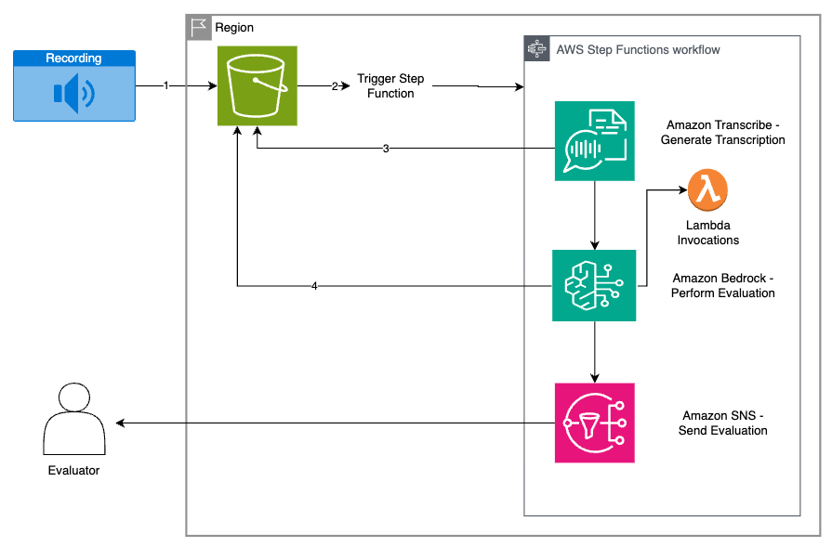
Architecture Overview
Notes:
Recording – An audio file, such as a meeting or support call, to be transcribed and summarized
Step Functions workflow – Coordinates the transcription and evaluation process
Amazon Transcribe – Converts audio recordings into text
Amazon Bedrock – Evaluates the transcription for English proficiency
Amazon SNS – Delivers the evaluation to the designated recipient
Recipient – Receives the evaluation report
Website hosted in S3 static and served using a CloudFront Distribution

Slide 7
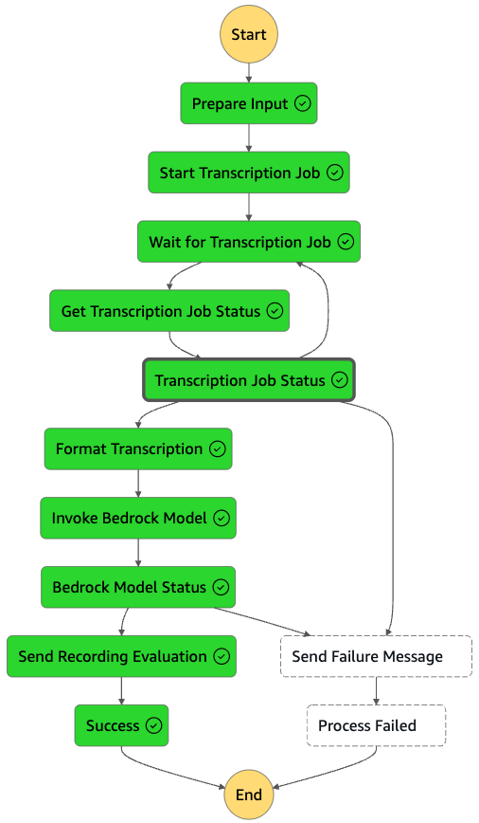
AWS Step Functions Overview This is an architectural representation of how Amazon Personalize trains a recommendation engine on custom data.
Steps
1
1
AWS Lambda prepares Input and sends audio file to Transcription Job in Amazon Transcribe.
2
Once complete, AWS Lambda function formats transcription output into a speaker transcription text file.
3
Amazon Bedrock invokes specified model using prompt and transcription input.
2
3
4
Recording Evaluation Response from Amazon Bedrock sent to user (student or teacher).
4

Slide 8
Pricing Estimates
Service | Cost ($ per month)
Amazon CloudFront (static website hosting) | $17.00
Amazon S3 | $0.18
Amazon Transcribe | $528.00
Amazon Bedrock | $20.80
AWS Lambda | $0.85
AWS Simple Notification Service | $0.18
AWS Step Functions | $2.90
AWS Developer Support | $29.00
Total | $599.39
Estimated monthly cost: $599.39
Assumptions:
10,000 monthly users
2-minute exam each monthly using PII Redaction
Total: 10,000 monthly users
The breakdown includes costs for hosting, transcriptions, storage, serverless compute, and developer support.
Notes:
https://calculator.aws/#/estimate?id=d317e98583eaa7280e133305606a45fbb4c1d811
Estimates are 5600 - 6000 tokens per minute in audio file (0.06 per user for input and 0.01 per user output)
Cheaper to use Amazon Transcribe than Nova Sonic
1.2 million seconds of audio transcription per month: 10,000 students x 120 seconds
Using batch streaming saves cost
Bedrock Data Automation: 20,000 minutes x $0.006 per minute = $120, however this is on standard output and does not provide you an audio transcription or channel separation by speaker, which is critical for evaluation of a specific speaker’s English Proficiency.
Will likely require custom output to handle English proficiency analysis, which will cost more per minute ($0.009).
Availability: Transcribe is more generally available as Bedrock Data Automation is currently only supported in us-west-2 and us-east-1.
Customer has a need to support global English proficiency assessment (APJ)

Slide 9
Next Steps
Import CloudFormation Template
Define Model Selection and Prompt Template
Add Bedrock Guardrails for Enhanced Security
Upload recordings to Amazon S3
Download Summary and Evaluation Results!
Notes:
CloudFormation Template
Import the pre-configured template to automatically set up your AWS infrastructure, including necessary IAM roles, permissions, and resource configurations.
Model Selection & Prompt Template
Choose your preferred AI model and define how it should process inputs and generate responses, including specific parameters for tone, length, and format of interactions.
Bedrock Guardrails
Implement security measures and content controls to ensure responsible AI use, protect sensitive information, and maintain compliance with organizational policies.
S3 Recording Upload
Store and manage audio recordings in Amazon S3, providing secure, scalable storage with easy access for processing and analysis.
Summary & Evaluation
Access comprehensive reports showing performance metrics, usage patterns, and quality assessments of the AI interactions and processing results.

Slide 10

Thanks! Any Questions?
Andrew Orlosky
AWS Solutions Architect
aorlosk@amazon.com
Notes:
https://aws.amazon.com/blogs/machine-learning/summarize-call-transcriptions-securely-with-amazon-transcribe-and-amazon-bedrock-guardrails/

